Slide 1
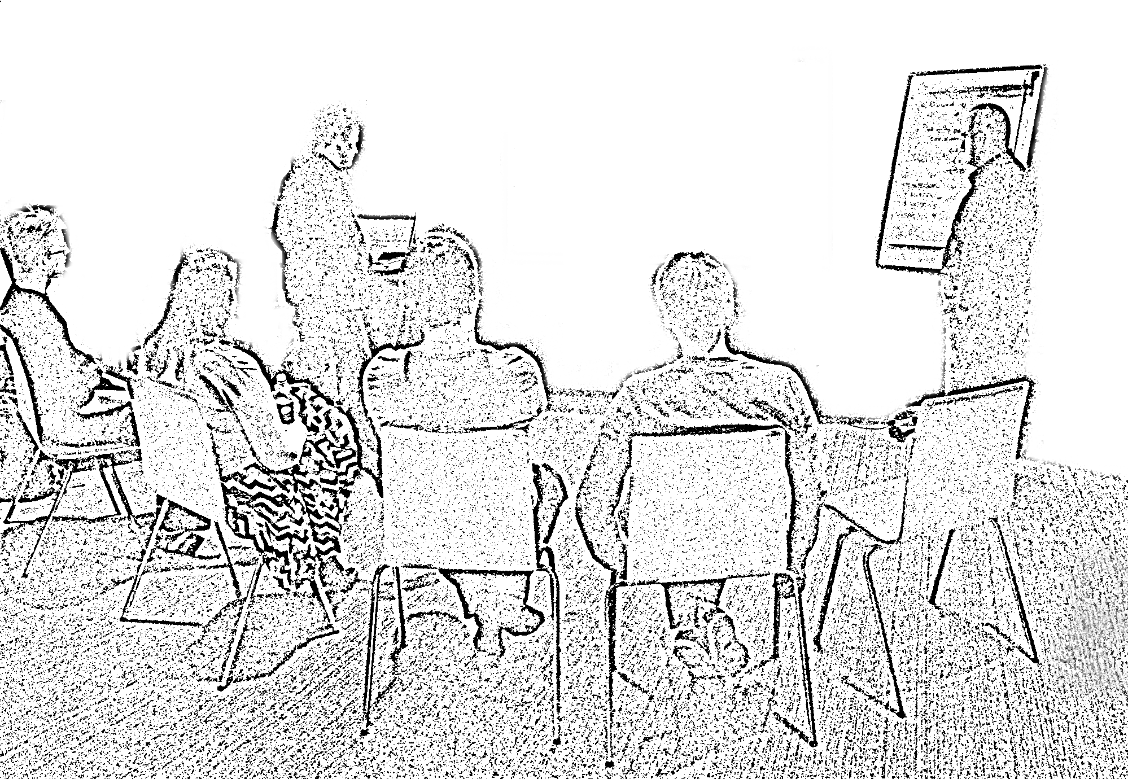
The
Mob Programming
Guidebook
Llewellyn Falco & Maaret Pyhäjärvi

Slide 2


The
Mob Programming
Guidebook
Llewellyn Falco & Maaret Pyhäjärvi

Slide 3



About the authors
Maaret Pyhäjärvi
Llewellyn Falco
Maaret Pyhäjärvi is a tester extraordinaire specializing in breaking illusions about software through means of exploratory testing. She is a software specialist with soft spots for hands-on testing, helping teams grow and building successful products and businesses. She’s been working with software since 1995 in various roles and delivers talks as popular speaker in Finland as well as internationally. She works as a tester at Granlund and trains testing on the side through Altom.
Llewellyn Falco is an Agile Technical Coach specializing in Legacy Code and Test Driven Development. He is the creator of the open source testing tool ApprovalTests, discoverer of Strong-style pairing, and the co-founder of “Teaching Kids Programing”
He has been using mob programming for teaching and coaching since 2010.

Slide 4
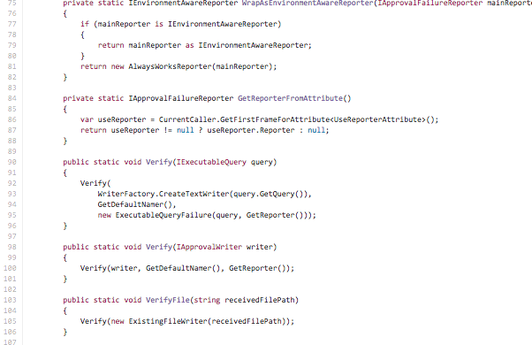
All the brilliant people, working on the same thing, at the same time, in the same space, and at the same computer.
Mobbing is not about getting the Most from your team.
It’s about getting the Best out of your team.
Mob Programming is a way to create hyper-productive fast learning teams.
Some of the benefits include:
Continuous learning
Shared ownership
Higher quality
Higher communication
Problems are discovered & fixed immediately
Lower technical debt
Less meetings
Happier teams
This book outlines the step-by-step approach to introduce Mob Programming to new teams to avoid common mistakes. It lays the foundation for successful introduction to get your entire team working together, with everybody contributing and learning, and treating each other kindness, consideration and respect.

